Slide 1
Warsaw, 11/29/2022
Fighting disinformation: fact-checking and media literacy
Speaker:
Adam Maternik

Slide 2
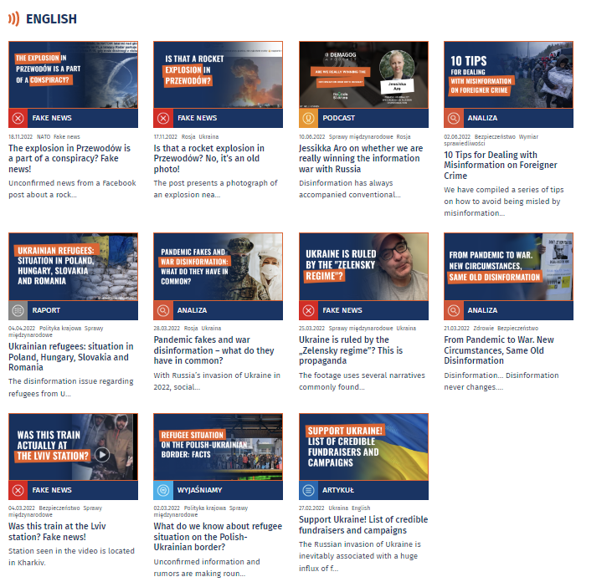
Fact-checking
Fact checking – the process of verifying that all the facts in a piece of writing, a news article, a speech are correct.
Since the war in Ukraine has broken out, Demagog Association debunked over 240 misleading claims regarding conflict.
We analysed narratives of anti-refugee disinformation in Poland, Slovakia, Hungary and Romania.

Slide 3
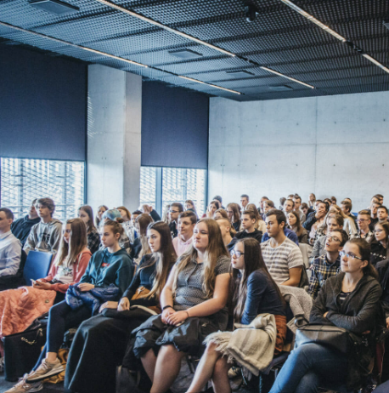
Media literacy
Media literacy education is an activity aimed at increasing digital competences and supporting critical thinking.
Media literacy can be treated as a separate subject or addition to other subjects such as computer science, mathematics and social studies.
Demagog Association has reached over 5,000 pupils across Poland as part of an educational project.

Slide 4
Prebunking
Prebunking is about raising awareness regarding manipulation techniques in order to build resilience to potential disinformation campaigns in the future.
Pre-bunking is grounded on inoculation theory. Prevention is better than cure.
Two prebunking videos concerning anti-refugee rhetoric have exceeded 13 million views on Polish YouTube.

